Slide 1
Linguistic Approach to the Cognitively Plausible Deep Neural Architectures
Gantavya Bhatt 2016EE10694
Hritik Bansal 2016EE10071
18 Sept 2019

Slide 2
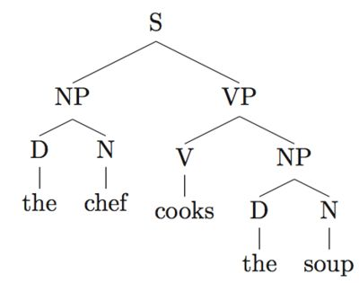
Introduction
Creating cognitive and biologically inspired neural networks
Learning syntax sensitive dependencies
Comparing different models on various metrics
Subject Verb Agreement Task
Grammaticality Check
Language Modelling
Analyzing the effect of these models on similar sentences

Slide 3
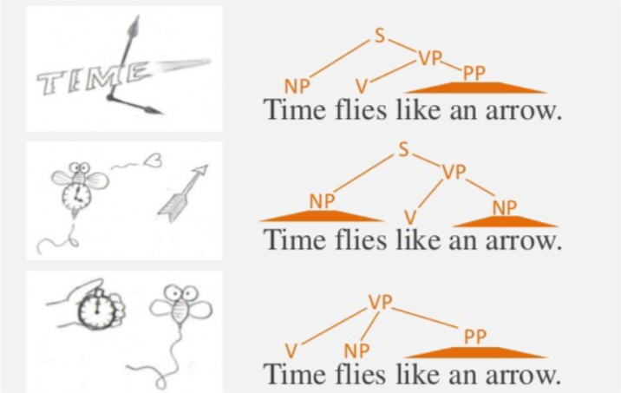
Why syntax is cognitively important ?
Image courtesy : POS Tagging [8]

Slide 4
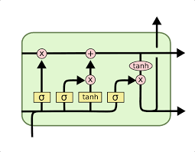
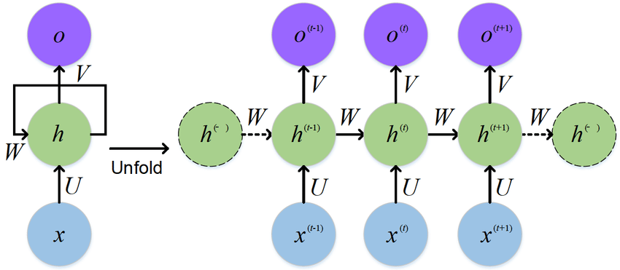
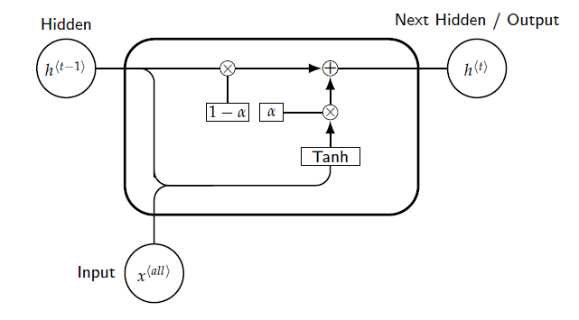
Well-established Models
LSTM
RNN
EIRNN [2]

Slide 5
Tasks Description
Subject Verb Agreement as an evidence of Syntax Dependencies
The key is on the table / *The key are on the table [ Look at the number of verb and head !! ]
The keys to the cabinet are on the table [ Presence of intervening nouns with opp. Number !! ]
Grammaticality Judgements
Predict if the sentence if grammatical or not with input as complete sentence
Weak supervision - Unlike previous objectives, it doesn’t give any syntactic cues to the model
Other variant- Grammaticality Plus
Language Modelling
The goal of the network is to predict next word at each point in every sentence
The keys to the cabinet : P(are) > P(is) ?

Slide 6
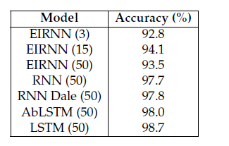
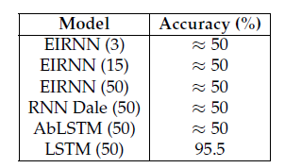
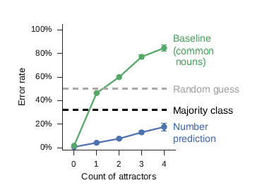
Comparison among previous models
RNNs are incapable of capturing long term dependencies, but they have better structural models
EIRNNs performed well on Number Prediction Tasks even without sequential nature[1]
EIRNN didn’t perform very well on Grammaticality - maybe due to absence of sequentiality
Performance of each model deteriorate with increasing number of intervening noun attractors[1].
Number Prediction Task[5]
Grammaticality Task[5]
LSTM with increase in # attractors[1]

Slide 7
Other Architectures

Slide 8
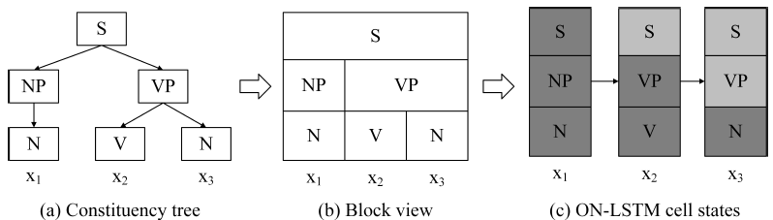
Ordered Neuron LSTMs (Shen et. al., ICLR 2019)
This LSTM architecture imposes a prior of tree based sentence constituency parsing.
ON-LSTM includes a new gating mechanism and a new activation function cumulative softmax.[4]
Awarded with the best paper award for International Conference on Learning Representations, 2019.

Slide 9
Decay RNN (Our Group)
Our group proposed an architecture that is between LSTMs and RNNs.
Taking inspiration from the decaying nature of the voltage of a neuron membrane after receiving activation from preceding neurons, we write following equation -
Note that, ɑ is a learnable scalar called the decay parameter.
The term can be thought of a hidden memory state.

Slide 10
Saccade CNN - SaCNN (Our group)
CNNs are generally less used in the NLP tasks because of their inability to work with inputs that do not have fixed length and reducibility to skip gram model.
However, as per Yin et. al. CNNs are not too bad when dealt with the NLP tasks.
We propose a CNN architecture that takes inspiration from human reading ability and saccades.
Humans can only see a particular word clearly on which they are currently focussing, and then gradually plans the next saccade to process the sentence (shown on the next slide).
We exploited this behavior and imposed this bias on the word processing of the CNNs

Slide 11
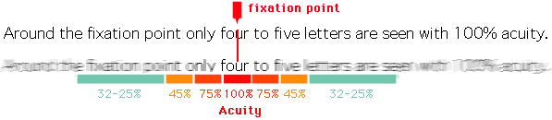
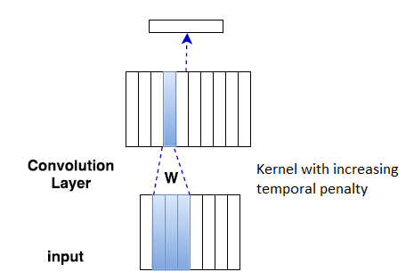
Image courtesy - Foveal Vision in reading [6]

Slide 12
Results for Inflection, plus10 and full grammaticality tasks
 | LSTM(2L) | Decay RNN(2L) | CNN(2L)
Verb Number Prediction | 98.9% | 98.62% | 96.93%
Plus 10 task | 97.05% | 96.9% | 90.81%
Grammaticality | 95.73% | 91.9% | 79.39%

Slide 13
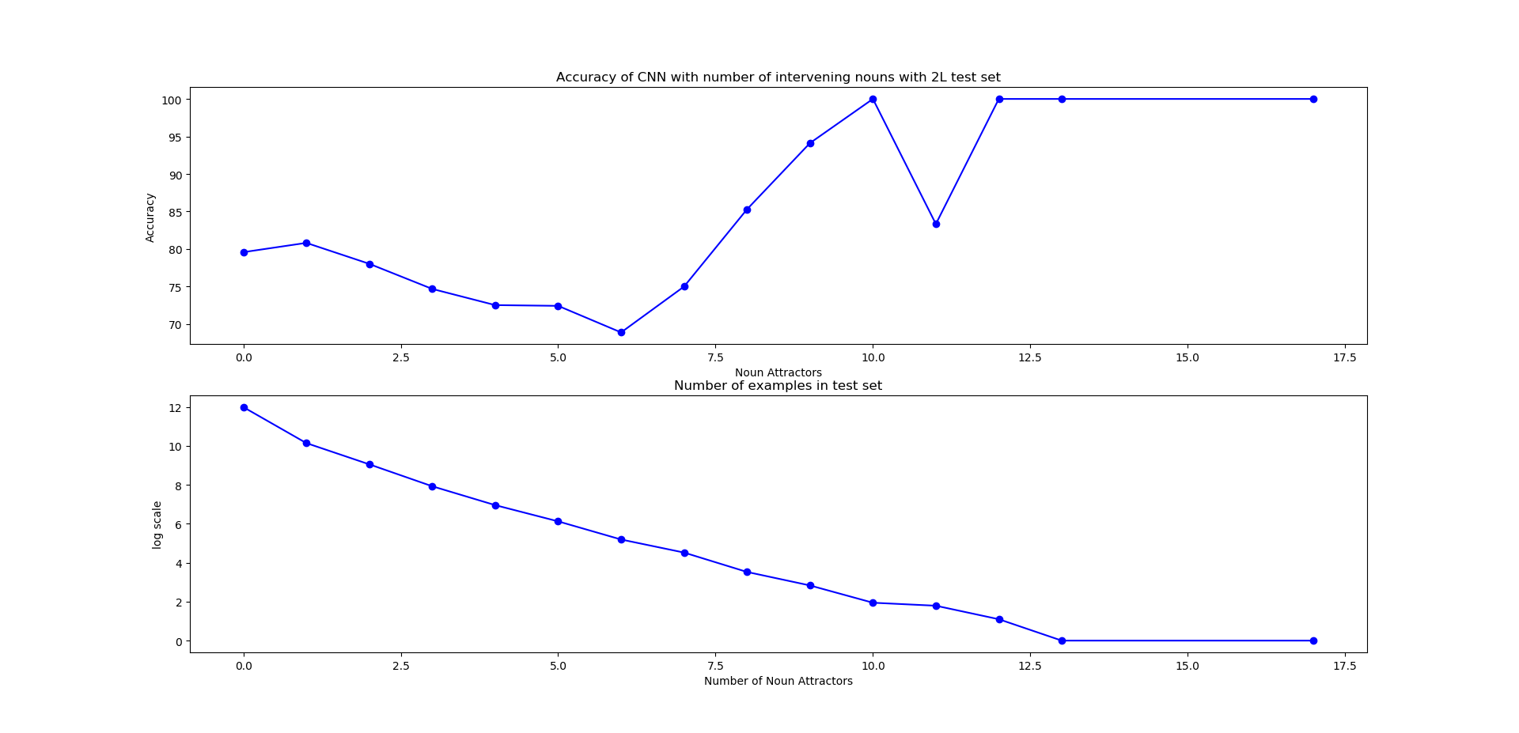
Results on Full Grammaticality- SaCNN

Slide 14
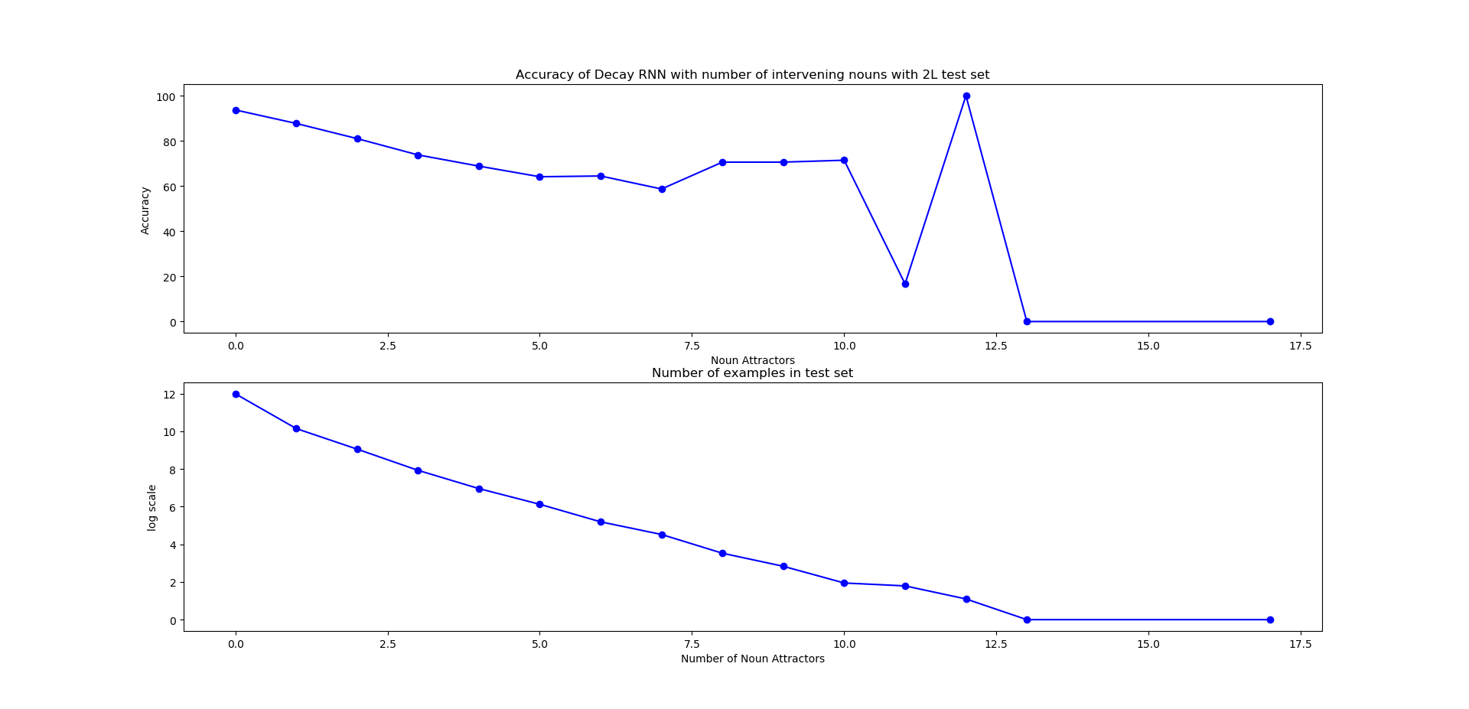
Results on Full Grammaticality- DECAY RNN

Slide 15
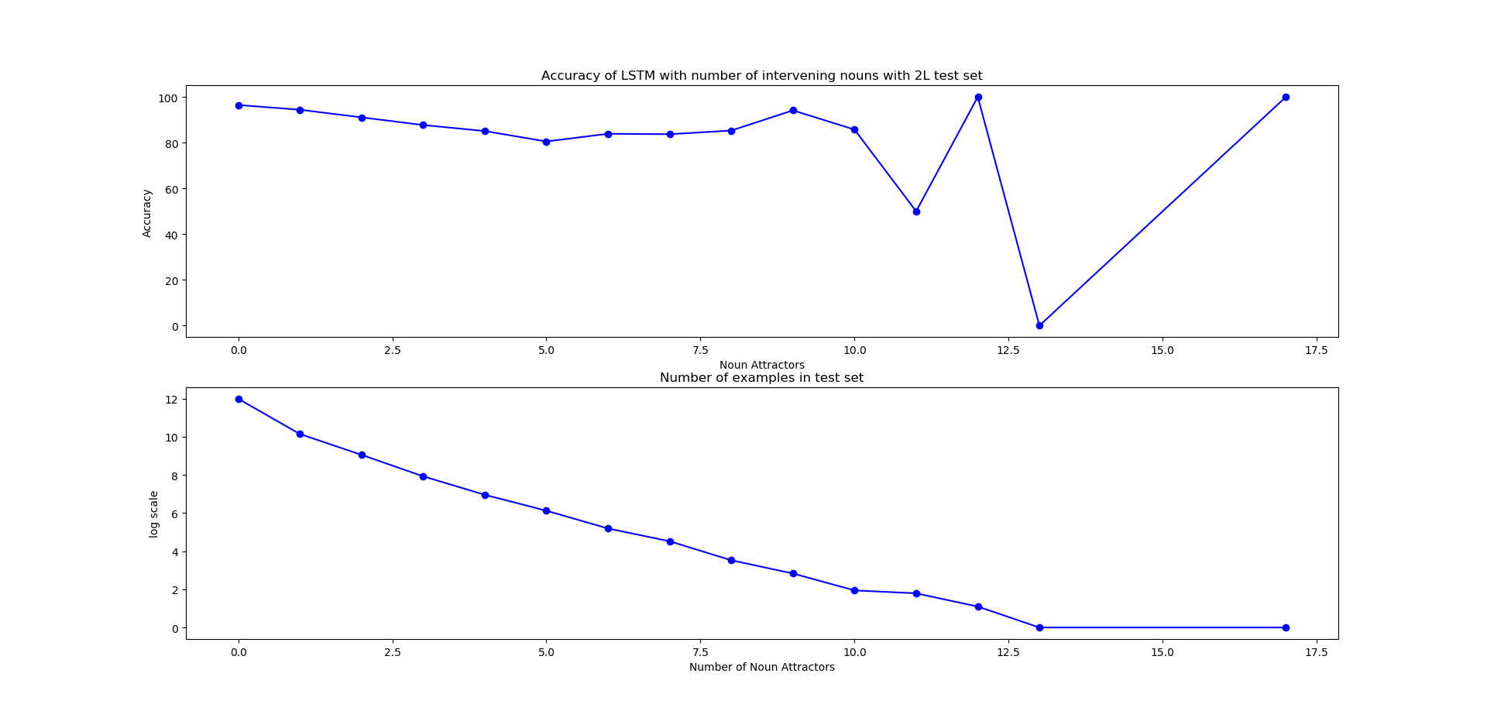
Results on Full Grammaticality- LSTMs

Slide 16
Grammaticality predictions by models along with ground labels
 | Ground truth of Grammaticality | Decay RNN Prediction | LSTM Prediction
a few folk tales features a boy discovering a NN or a NN assumed to be of great value . | Incorrect | Incorrect | Correct
some sources calls them NNS now because there is finally a term for what those couples are . | Incorrect | Incorrect | Incorrect

Slide 17
 | Ground truth of Grammaticality | Decay RNN Prediction | LSTM Prediction
if there is something the world RB needs , it is people who think about how to improve the way we run things . | Correct | Incorrect | Correct
a similar suspension is the JJ rear suspension , in which the beam NN also function as an JJ bar to control the roll motion of the body . | Incorrect | Correct | Correct

Slide 18
Future Prospects...

Slide 19
As of now, the tasks we have performed are binary prediction. However, these tasks are not enough to investigate the capabilities of the model proposed by our group
Part of Speech tagging - to understand if the model is actually learning the Subject Verb Agreement.
Language Modelling.
Cognitive CNN : We are using a fixed decay vector to train the model but,
What happens when we make the decay setting to be bounded learnable? Will this lead to the same hyper ellipsoid in parameter space?
Decay RNN : As per current settings, the decay parameter is not bounded but,
What happens when the decay parameter is forced to be bounded ?
When can we see see the vanishing and exploding gradient situation, mathematically?
When our model can converge to existing sequence models?

Slide 20
References
Tal Linzen, Emmanuel Dupoux, and Yoav Goldberg. 2016. Assessing the ability of LSTMs to learn syntax-sensitive dependencies. In TACL.
H Francis Song, Guangyu R Yang, and Xiao-Jing Wang. Training excitatory-inhibitory recurrent neural networks for cognitive tasks: A simple and flexible framework. PLoS Comput Biol, 12(2): e1004792, 2016.
Rebecca Marvin and Tal Linzen. Targeted syntactic evaluation of language models. arXiv preprint arXiv:1808.09031, 2018
Yikang Shen, Shawn Tan, Alessandro Sordoni, and Aaron Courville. 2019. Ordered neurons: Integrating tree structures into recurrent neural networks. In ICLR.
“Recurrent Nets as cognitive models”, Singh Rishubh, IIT Delhi
Foveal Vision in reading, http://www.learning-systems.ch/multimedia/vis_e02.htm
W. Yin, K. Kann, M. Yu, and H. Schütze, “Comparative study of CNN and RNN for natural language processing,” arXiv Preprint, arXiv:1702.01923, 2017
POS Tagging , https://www.freecodecamp.org/news/an-introduction-to-part-of-speech-tagging-and-the-hidden-markov-model-953d45338f24/

Slide 21
Thanks!
" Geoff Hinton can make your weight decay (your weight, but unfortunately not mine)." -Yann LeCunn

